Slide 1

Automobile Engine Fault Diagnosis Using Machine Learning Method
School of Mechanical & Control Engineering
Handong Global Univ.
Oct.22.2024
Industrial AI & Automation
Project 1
Prof. Young-Keun Kim
21900416 An Gyeonheal
21900727 Jin Garam

Slide 2
CONTENTS
1. Proposal Review
2. Baseline Journal Implementation
3. Data Preprocessing
4. Classification Model Improvement
5. Result & Discussion

Slide 3
1. Proposal Review
- Objective -
By Developing a Model that Outperforms those Implemented in Existing Journals,
Accurately Identify types of Engine faults, Providing Greater Speed and Precision in Engine Repairs.
- Goal -
Journal F-1 Score of KNN (≥ 75.1% )
- Input -
- Output -
MAP, TPS, Force, Power, RPM, Consumption(L/H), Consumption(L/100), Speed, CO, HC, CO2, O2, Lambda, AFR
Fault type 0: Normal (16,000 entries)
Fault type 1: Rich mixture - High Pressure, Incorrect Sensor, etc. (10,988 entries)
Fault type 2: Lean mixture – Low Pressure, Incorrect Sensor, etc. (15,000 entries)
Fault type 3: Low Voltage – Worn Spark, Defective Coil, etc. (14,001 entries)

Slide 4
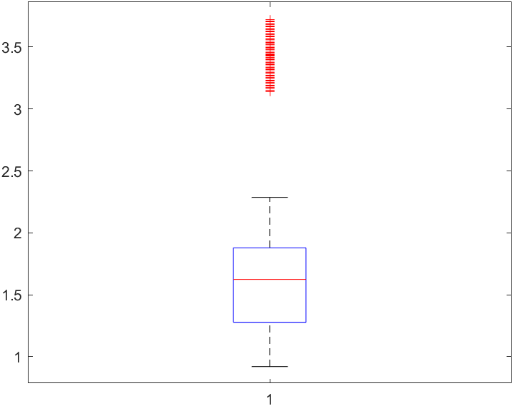
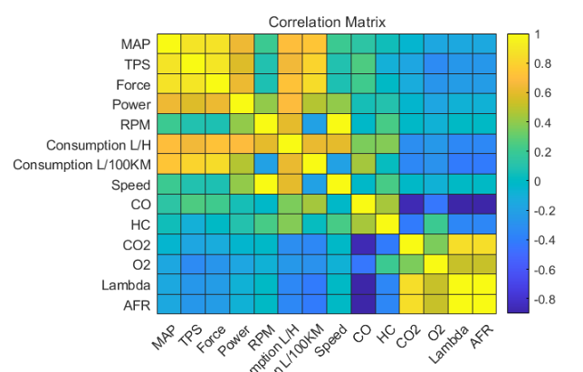
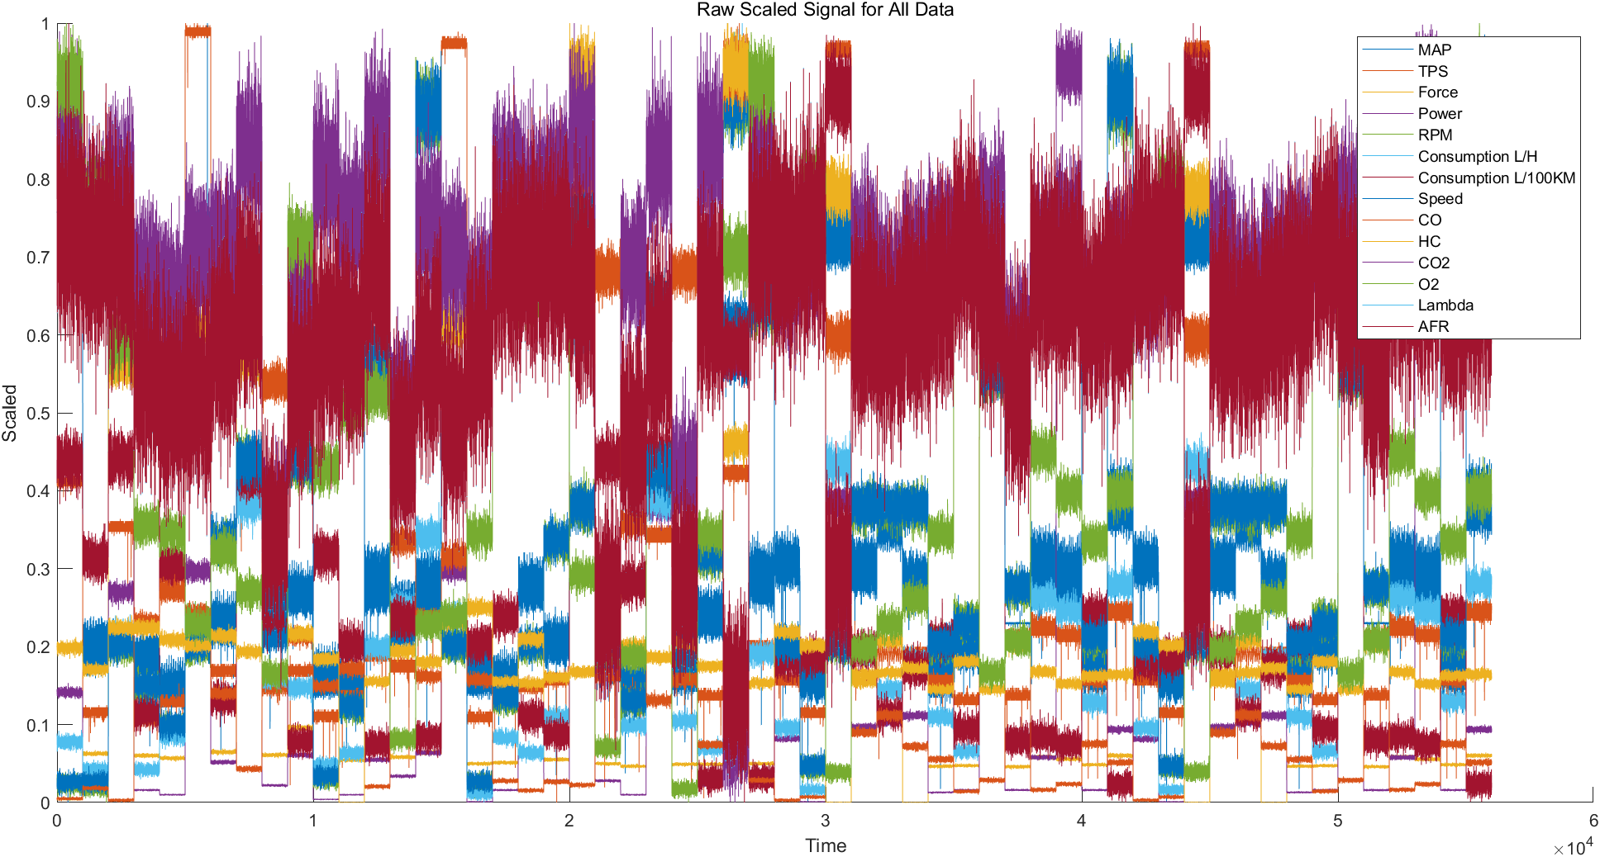
2. Baseline Journal Implementation
< Correlation Analysis >
< Box Plot Analysis>
 | SVM | TREE | KNN | LR
Accuracy | 0.59 | 0.74 | 0.75 | 0.48
Precision | 0.58 | 0.75 | 0.76 | 0.48
Recall | 0.59 | 0.75 | 0.76 | 0.50
F1 Score | 0.57 | 0.75 | 0.76 | 0.48
< Min-Max Scaling >
< Performance >

Slide 5
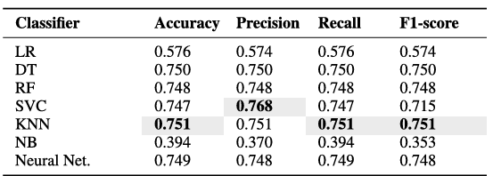
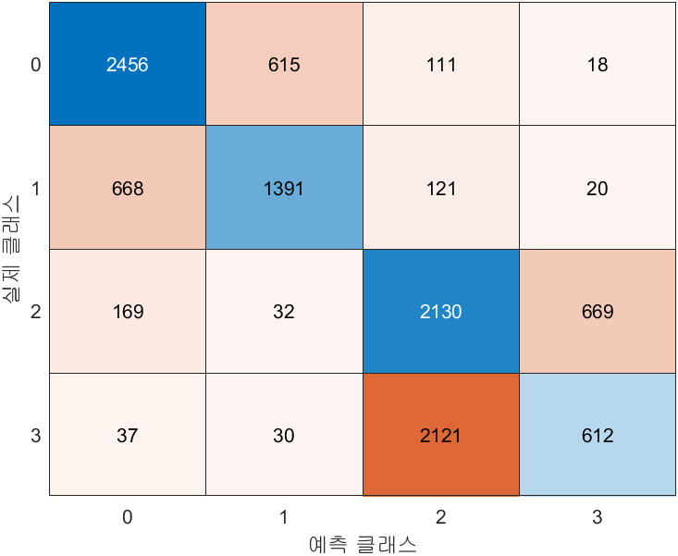
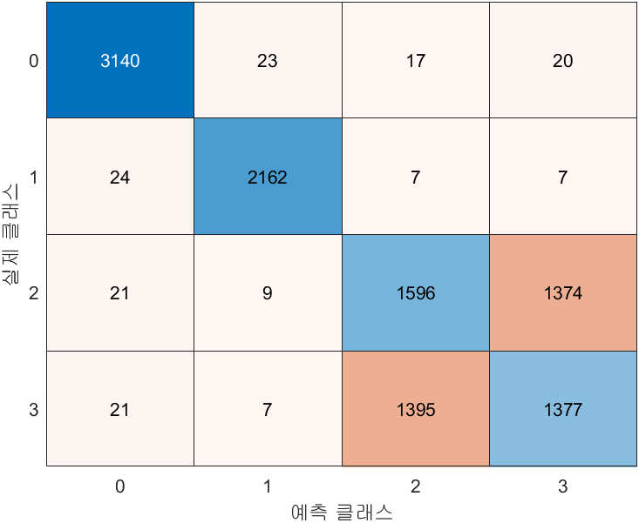
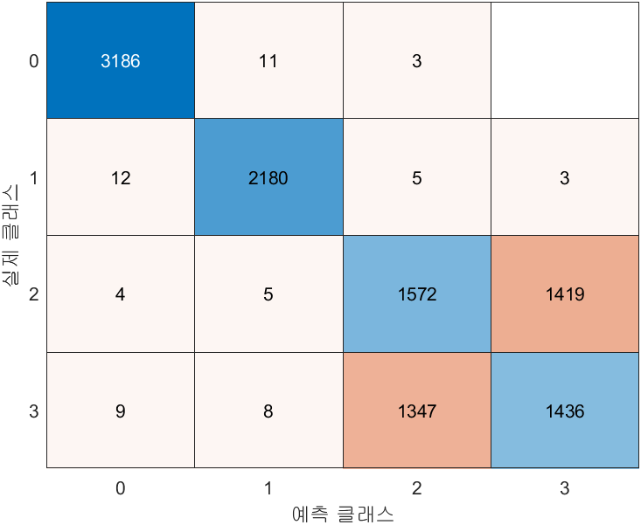
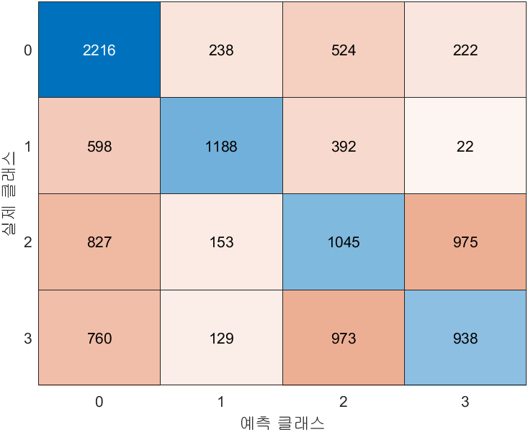
2. Baseline Journal Implementation
SVM
TREE
< Performance >
 | SVM | TREE | KNN | LR
Accuracy | 0.59 | 0.74 | 0.75 | 0.48
Precision | 0.58 | 0.75 | 0.76 | 0.48
Recall | 0.59 | 0.75 | 0.76 | 0.50
F1 Score | 0.57 | 0.75 | 0.76 | 0.48
KNN
Logistic Regression

Slide 6
2. Baseline Journal Implementation
TREE
How can we develop the performance?
SVM
X
< Performance >
 | SVM | TREE | KNN | LR
Accuracy | 0.59 | 0.74 | 0.75 | 0.48
Precision | 0.58 | 0.75 | 0.76 | 0.48
Recall | 0.59 | 0.75 | 0.76 | 0.50
F1 Score | 0.57 | 0.75 | 0.76 | 0.48
Feature Extraction / Feature Reduction / Selecting Features
KNN
Logistic Regression
Why?

Slide 7
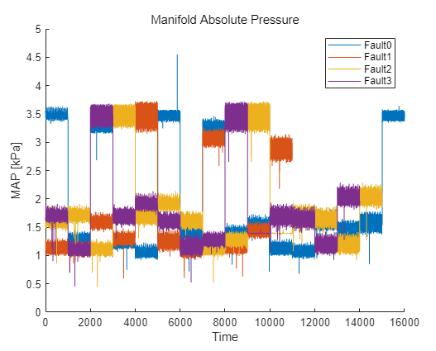
2. Baseline Journal Implementation
SVM
TREE
< Performance >
 | SVM | TREE | KNN | LR
Accuracy | 0.59 | 0.74 | 0.75 | 0.48
Precision | 0.58 | 0.75 | 0.76 | 0.48
Recall | 0.59 | 0.75 | 0.76 | 0.50
F1 Score | 0.57 | 0.75 | 0.76 | 0.48
KNN
Logistic Regression
1. This is Time-Series Data, But There is No Change Over Time.
2. It is Not Continuous and It is Measured for Various cases.
It’s Important to Focus on Data Distribution
→ Data Preprocessing is Necessary

Slide 8
3. Data Preprocessing
Proposal Objective | New Objective
Preprocessing | Preprocessing (Scaling, Train & Test Data)
Feature Extraction Feature Reduction Selecting Features | ?
Classification (SVM, Tree, KNN etc) | Classification (SVM, Tree, KNN etc)
Evaluation | Evaluation

Slide 9
3. Data Preprocessing
Data Analysis
Preprocessing
Train/Test Datasets Division
Classification
Optimization
Evaluation

Slide 10
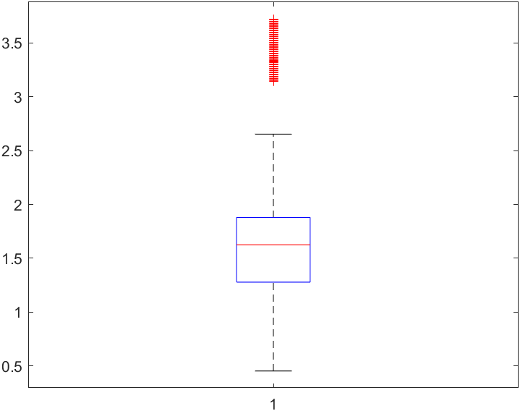
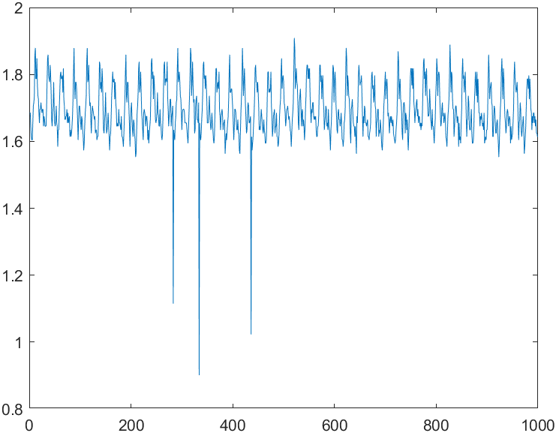
3. Data Preprocessing
1. Replacement Outlier
Using a linear method to remove the outliers.

Slide 11
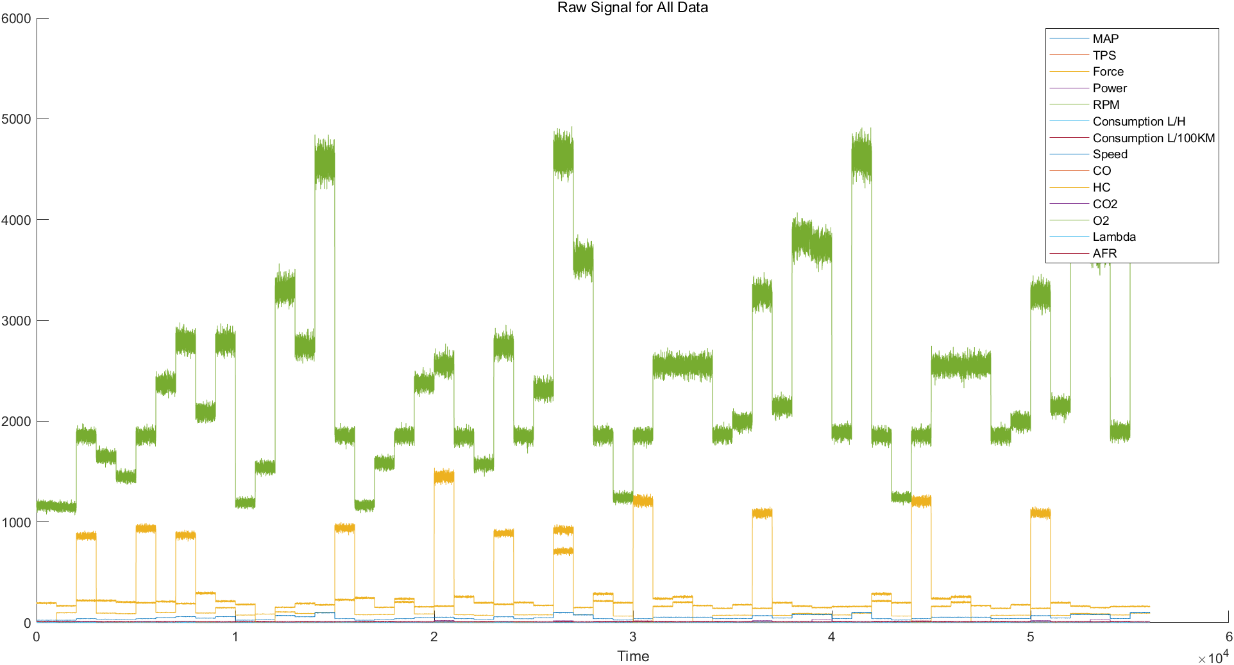
3. Data Preprocessing
2. Min-Max scaling
14 Variables have different magnitude ranges (ex. %, rpm, Pa etc.).
→ Min-Max Scaling [0, 1].

Slide 12
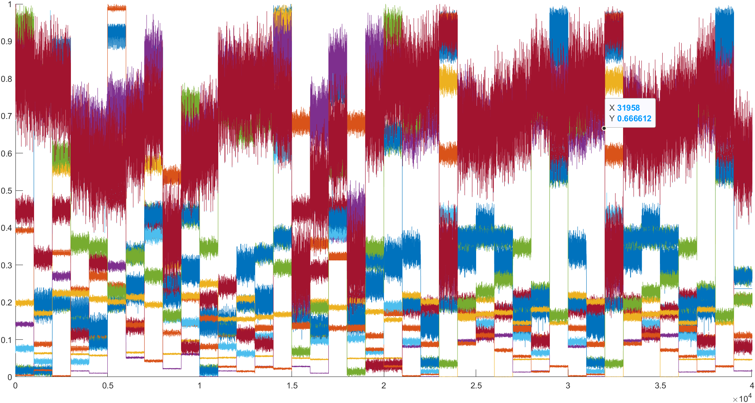
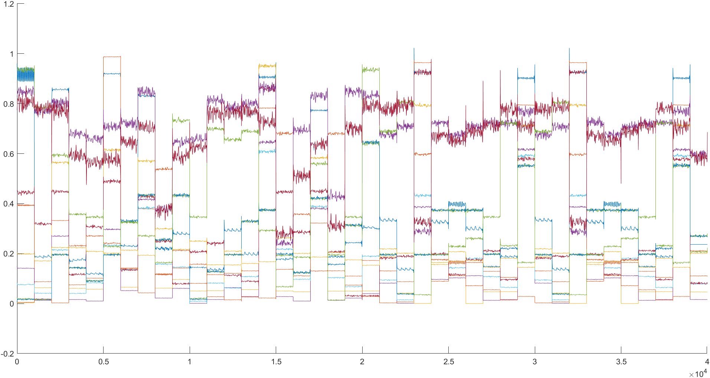
3. Data Preprocessing
3. Butterworth Low Pass Filter
Don’t Focus on Changes Over Time
Focus on the Distribution of Variables
Noise → Distributed with a Large Standard Deviation

Slide 13
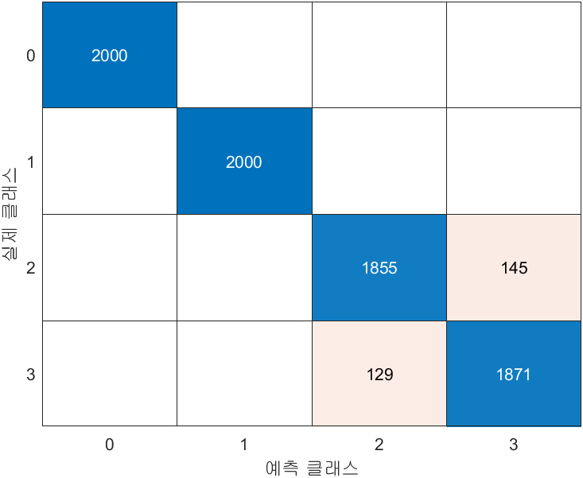
4. Classification Model Improvement
KNN-Number of data: 40,000(Train: 32,000, Test:8,000)
Accuracy: 0.97
Precision: 0.97
Recall: 0.97
F1-Score: 0.97

Slide 14
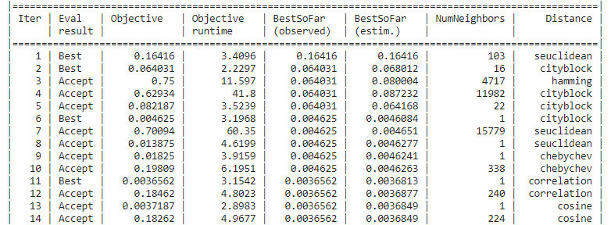

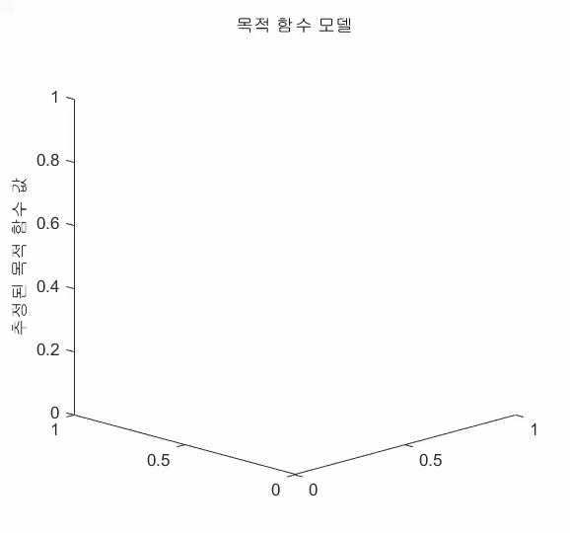
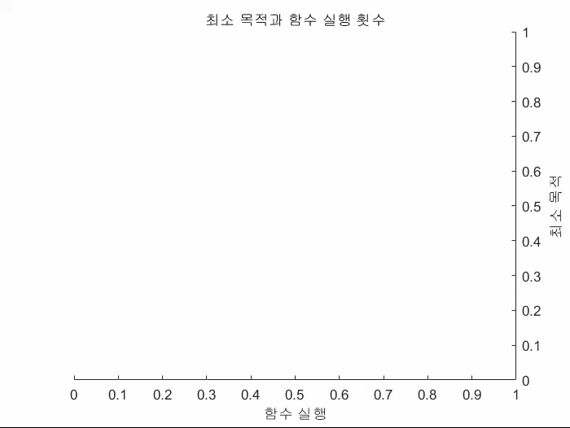
4. Classification Model Improvement
KNN-Number of data: 40,000(Optimization)
Accuracy: 0.99
Precision: 0.99
Recall: 0.99
F1-Score: 0.99

Slide 15
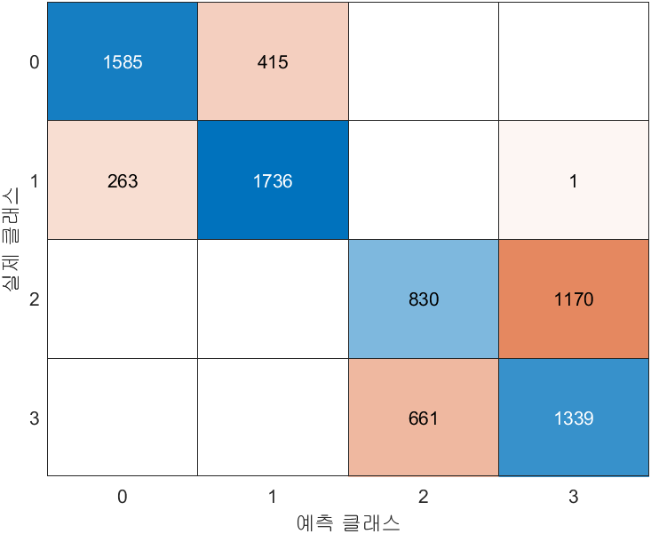

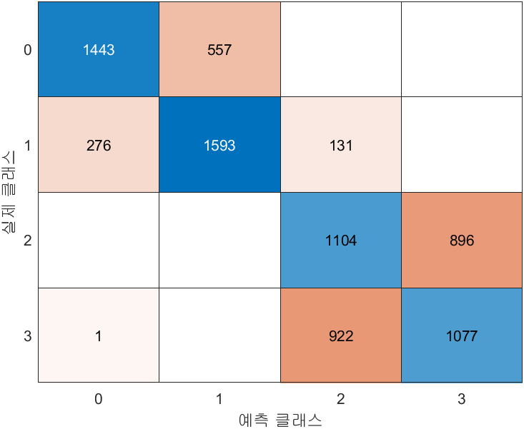
5. Result & Discussion
SVM
TREE
 | SVM | TREE | KNN | LR
Accuracy | 0.69 | 0.97 | 0.97 | 0.65
Precision | 0.69 | 0.97 | 0.97 | 0.65
Recall | 0.69 | 0.97 | 0.97 | 0.66
F1 Score | 0.68 | 0.97 | 0.97 | 0.65
KNN
LR
Notes:
모델의 성능을 향상시키기 위해서 전처리 작업이 중요하다. 우리는 feature extraction, 새로운 머신러닝 모델 시도 등 다양한 방법을 시도하였지만, 결국 전처리를 통해 높은 성능에 도달할 수 있었다. 또한 데이터의 형태를 먼저 파악하고 어떤 작업을 통해 성능을 개선할지도 요구된다.
Preprocessing is crucial for improving model performance. While we explored various methods such as feature extraction and experimenting with new machine learning models, it was ultimately through preprocessing that we achieved higher performance. Additionally, understanding the structure of the data first and determining which preprocessing steps are needed to enhance performance is essential.
모델의 특성: Decision Tree와 KNN은 비선형적인 분류 문제를 다룰 수 있는 특성을 가지고 있으며, SVM과 Logistic Regression은 선형적이거나 고차원 공간에서의 분류 문제에 더 적합합니다. 이 때문에 비선형 데이터에서 SVM과 LR의 성능이 낮을 수 있습니다.
Decision Tree는 섞여있는 데이터에서 하나씩 분류, KNN는 군집 안에 자신이 속한 그룹을 찾아가는 것이다.
SVM은 경계선과의 거리를 이용하여 가중치를 통해 분류하는 것이고, Logistic Regression은 시그모이드, 또는 로그 함수의 모양으로 분류한다.
A Decision Tree classifies data by splitting it one step at a time. KNN (k-Nearest Neighbors) identifies which group it belongs to by looking for the nearest neighbors within a cluster. SVM (Support Vector Machine) classifies data by using the distance from the boundary and applying weights to determine the classification. Logistic Regression classifies data using a sigmoid function, or sometimes a log function, to separate the data.
Model Characteristics: Decision Tree and KNN possess the ability to handle nonlinear classification problems, while SVM and Logistic Regression are more suited for linear or high-dimensional space classification tasks. This is why SVM and LR may exhibit lower performance on nonlinear data.

Slide 16
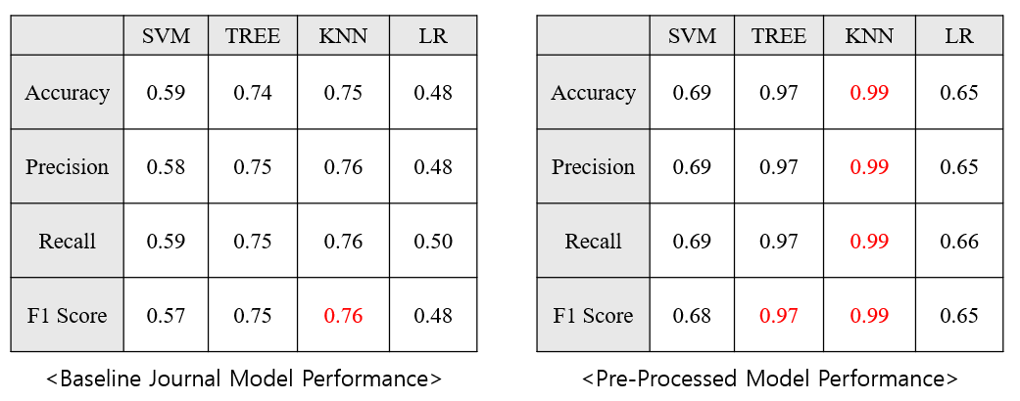
5. Result & Discussion
76% → 99% (+23%)
Why KNN & Tree Model has Better Performance than others?
KNN has benefited from having variables with similar patterns
Decision Tree(clear classification rules) has advantage in multiple input
KNN & Tree is vulnerable to noise → Butterworth Lowpass Filter

Slide 17
Reference
[1] Vergara, M., Ramos, L., Rivera-Campoverde, N. D., & Rivas-Echeverría, F. (2023). Enginefaultdb: a novel dataset for automotive engine fault classification and baseline results. IEEE Access, 11, 126155-126171.

